Slide 1


Data Analytics
27 June, 2024

Slide 2


Objectives
Using data analysis on a company's stock prices to identify good buying and selling opportunities.
Using Moving Averages and Rsi for our signals

Slide 3


Library Used
yfiniance. : Yahoo Finance is a Python library used to fetch financial market data
pandas: Pandas is a powerful Python library used for data analysis and manipulation
Mathplotlib: Matplotlib is a Python library used for data visualization
Numpy: Python library used for fast numerical computations and data processing

Slide 4



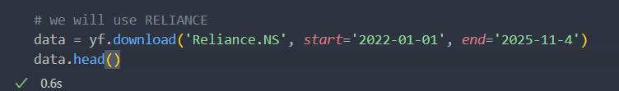
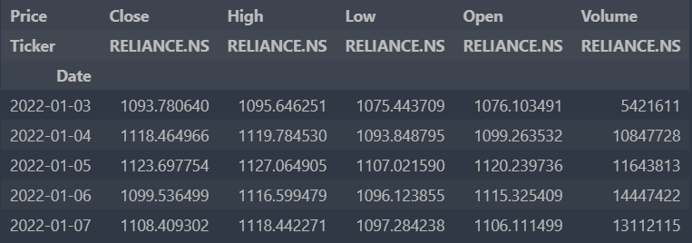
Loading Data
Lodaing Data Using yfiniance
1. data = yf.download('Reliance.NS', start='2022-01-01', end='2025-11-4’)
Reliance.NS this load the company data , start tells us form which date to start
end denotes the end date .
2. data will be a pandas data frame

Slide 5

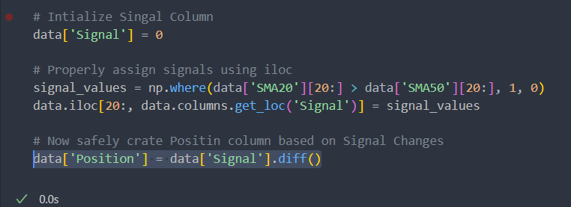

Calculating Moving Average
Takes the last 20 days/50 days of closing prices.
Calculates their average
Moves one day forward, and again takes the latest 20 days to compute a new average.
Making Buy and Sell signals
signal_values = np.where(data['SMA20'][20:] > data['SMA50'][20:], 1, 0)
SMA20 > SMA50 → 1 this is our buy signal
SMA20 ≤ SMA50 → 0 this is our sell signal
data.iloc[20:, data.columns.get_loc('Signal')] = signal_values
Puts sell signals into data frame but from but only starting from row 20
because the first 20 rows don’t have enough data to calculate the SMA
data['Position'] = data['Signal'].diff()
It finds when the signal changes

Slide 6

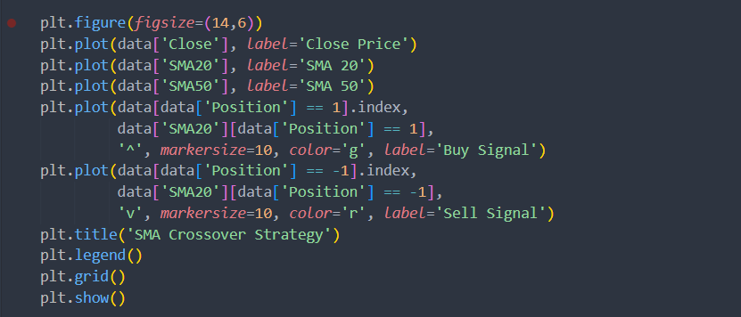
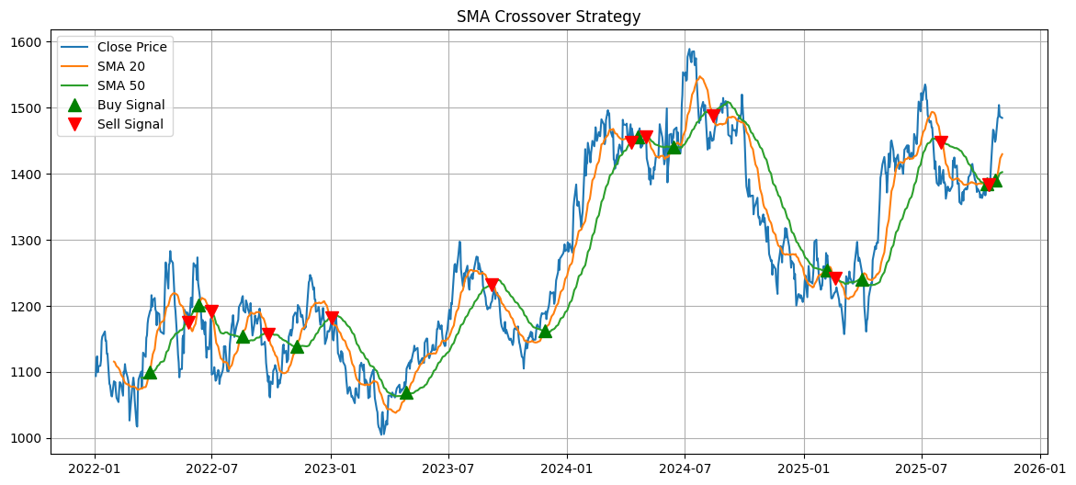
Plotting Chart

Slide 7
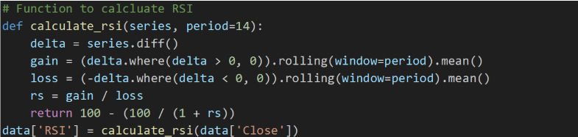

Plotting chat base on Rsi Value
RSI stands for Relative Strength Index.
It’s a simple tool that measures how fast and strong the stock price is moving.
When RSI goes above 70, it usually means the stock is getting too expensive — and it might be time to sell.
When RSI drops below 30, it means the stock might be cheap — and it could be a good time to buy
gain = (delta.where(delta > 0, 0)).rolling(window=period).mean()
Keeps only the positive changes (gains), others become 0
Takes the average gain over 14 days.
loss = (-delta.where(delta < 0, 0)).rolling(window=period).mean()
Keeps only the negative changes (losses), makes them positive
Takes the average loss over 14 days

Slide 8

Create Buy/Sell Signals
data.loc[data['RSI'] < 30, 'Signal'] = 1
If RSI < 30 oversold stock might go up soon → Buy signal
data.loc[data['RSI'] > 70, 'Signal'] = -1
RSI > 70 overbought stock might fall soon → Sell signal
data['Position'] = data['Signal'].diff()
Calculates the difference between today’s and yesterday’s signal.

Slide 9
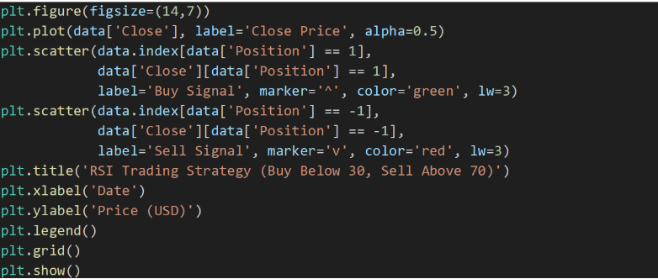
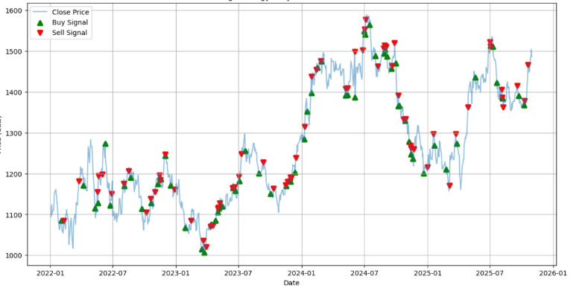
Plotting Chart

Slide 10

Thank You

